Slide 1
Data engineering
Arend Valvekens, Mardiros Gundes, Simon Stercks, Milan Vermeiren, Bram Baestaens, Robin Dewinter

Slide 2

Contents
Intro
Data engineering process
Data pipeline
ETL
ELT
Data warehousing
Data lake
Data vault

Slide 3
Contents
Data marts
OLAP cubes
Big data engineering
Hadoop and it’s ecosystem

Slide 4
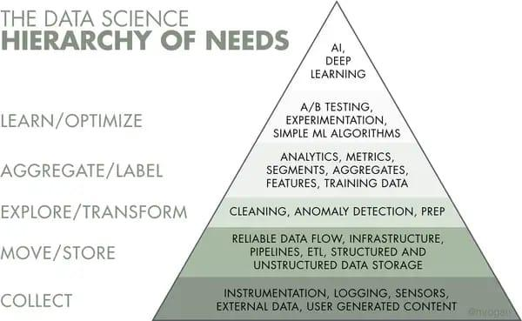
What is data engineering?
Set of operations
Data available and usable
Create usable data
Storing data at scale
Further analysis
Notes:
set of operations - to make data available and usable to data scientists, analysts, …

Slide 5
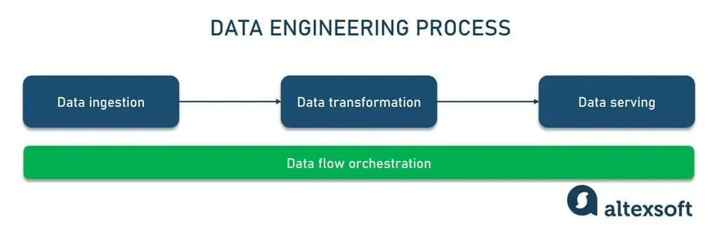
Data engineering process
Sequence of tasks
Data ingestion
Data transformation
Data serving

Slide 6
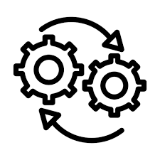
Data engineering process
Data ingestion
Move collected data
Structured or unstructured
Data transformation
Adjust data to the needs of end users; cleaning
Data serving
Deliver the actual data
Data flow orchestration
Notes:
moving collected data from databases: nosql, multiple sources to a target system to be transformed for further analysis.
dagster for data flow orchestration example

Slide 7
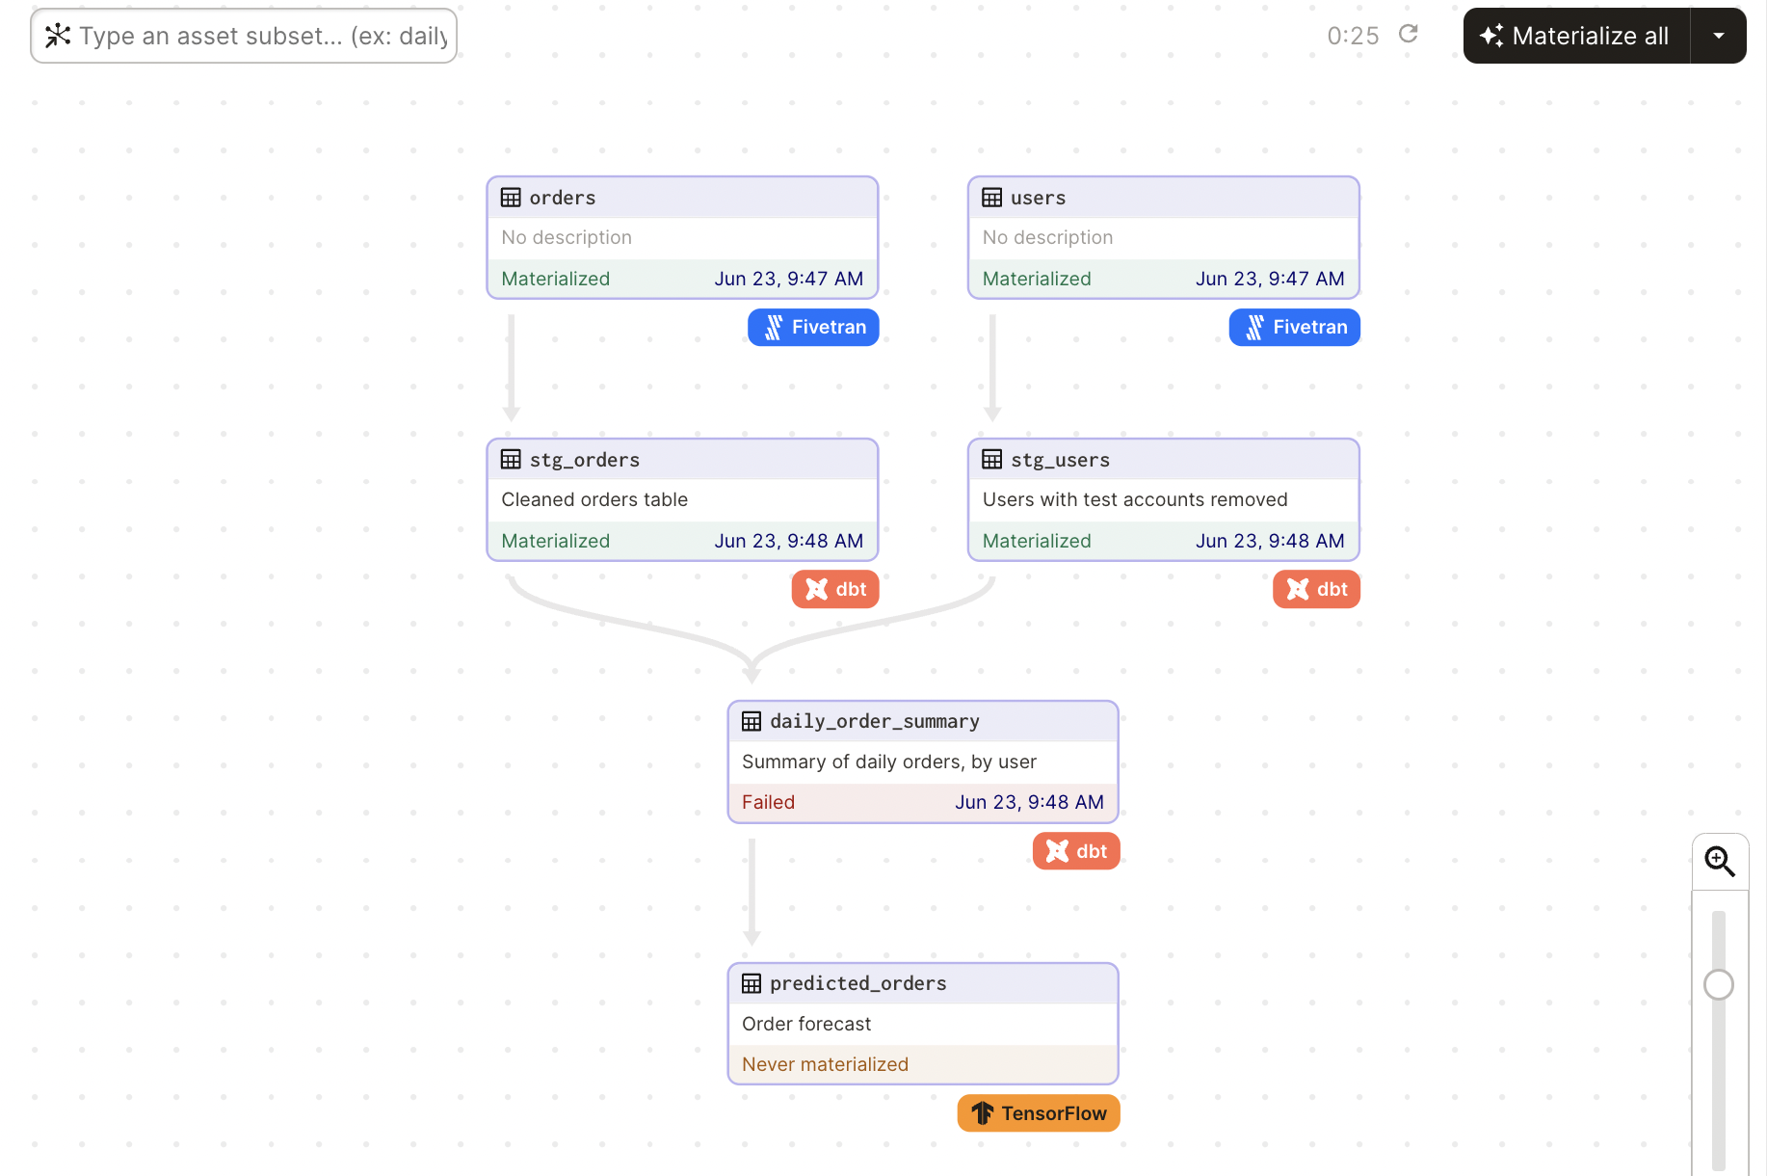
Data flow orchestration: Dagster pipeline

Slide 8

Data pipeline
Combination of tools
Constructing and maintaining pipelines
Commonly used for:
Data migration
Data wrangling
Data integration
Copying tables to other databases
Types of pipeline:
ETL
ELT
Notes:
- combination of tools to move data from one place toa nother
primary use case for these is automation
data wrangled = converting raw data into usable formats for analytics
data integration from for example iOt devices
copying full tables to toher databases

Slide 9
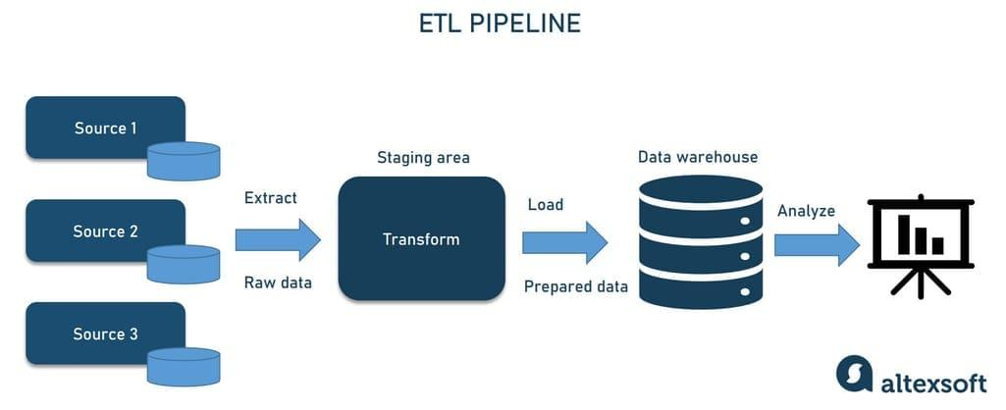
ETL (extract, transform, load)
Notes:
you retrieve the data at the start of your pipeline from different sources
you then transform it to standardize the data; transforming it to different formats
finally you load the transformed data; means saving it to a new destination this is usually a DBMS or a data warehouse
and finally you can analyze the data
on the other hand

Slide 10
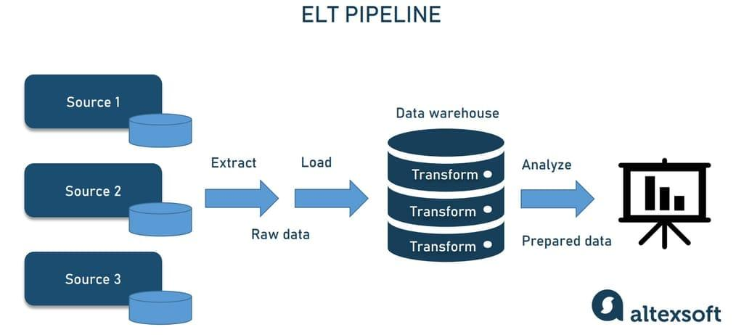
ELT (extract, load, transform)
Notes:
instead: you immediately put it into a data warehouse or a data lakehouse
this practice is more common for large scale data operations
as a means for prioritizing having the data and doing transformations on it later
a plus when using this is you don’t have to worry about data types or formats in advance, you can always decide later

Slide 11

Data pipeline
Many things need to be considered
Corrupted data?
Bottlenecks?
Latency?
Conflicting sources?
…
The solution?
Notes:
in order to decide which one you should there is many things that need to be considered.
things like is it it possible the data i’m fetching is actually corrupted?
will there be bottlenecks, maybe one part of the pipeline becomes congested after a while
how to deal with latency
what if there is conflicting data sources and so on
the solution for this is data warehousing

Slide 12

Data warehousing
Data warehouse (DW)
Central repository
Often relational database
Traditionally, only structured
Modern also unstructured
Without DW’s -> pull from production; different results to the same question
Delays and outages
Single source of truth
Not a regular database. How so?
Notes:
a solution is data warehousing
central repository where all extracted data will be stored
often these are relational databases
traditionally only stored structured data but they have evolved to also supporpt unstrutctured data
without a DW data would have to always be pulled from production, which could return different results to the same questions
there’s also possible delays and outages to consider
using a data warehouse makes it so taht you have a single source of truth
it sounds like a normal data base but it is very different

Slide 13
Data warehousing
Differs in data structures
Normal DB -> typically normalized
Takes a lot of resources
DW uses simple queries
Store historical data -> simplifies data analyst’s job
Data visualisations and statistics
Notes:
they differ in data structure
typically a normal DB is normalized and this takes alot of resources
eg. joining lots of different tables to get an overview of your data compared to just simple select queries.
DW’s often store a ton of historical data with timestamps, this simplifies the data analysts job when they do visualisations and statistics

Slide 14
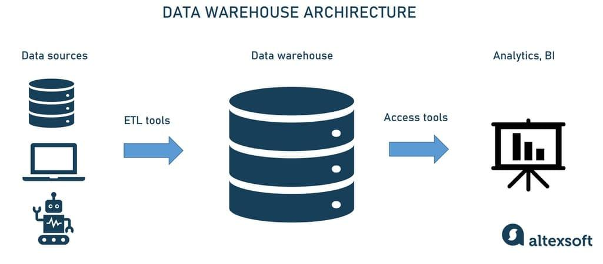
Typical data warehouse architecture
Notes:
this is what a typical data warehouse architecture looks like
so you have your data sources, you extract, transform and load your data into a data warehouse which then becomes accessible to dashboards and analytics.
theres different strategies to creating a data ware house architecture
one such strategy or modelling approach is called data vault

Slide 15
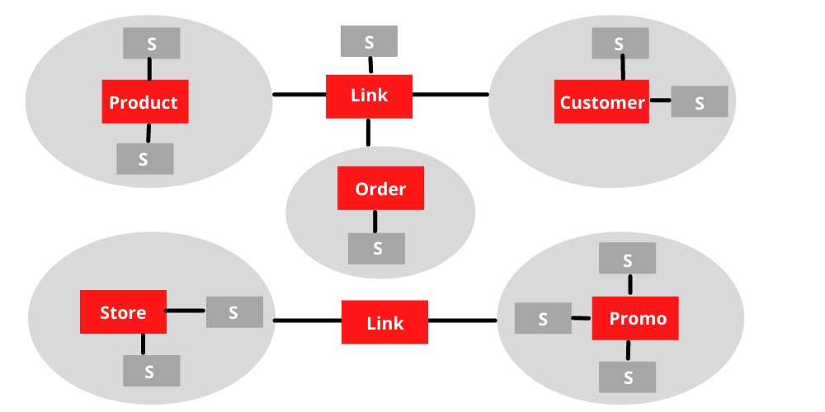
Data Vault Warehousing
Dynamic and adaptable
For scalable enterprise data warehouses
<-> 3NF and traditional warehousing methods
agile, flexible and scalable solution
To provide a consistent framework
Notes:
Data vaults address the challenges of the third normal form 3NF, 3NF is a normalization method for reducing duplication and data integritiy, and traditional warehousing methods like the star and snowflake schema’s, while also combining their strengths.

Slide 16
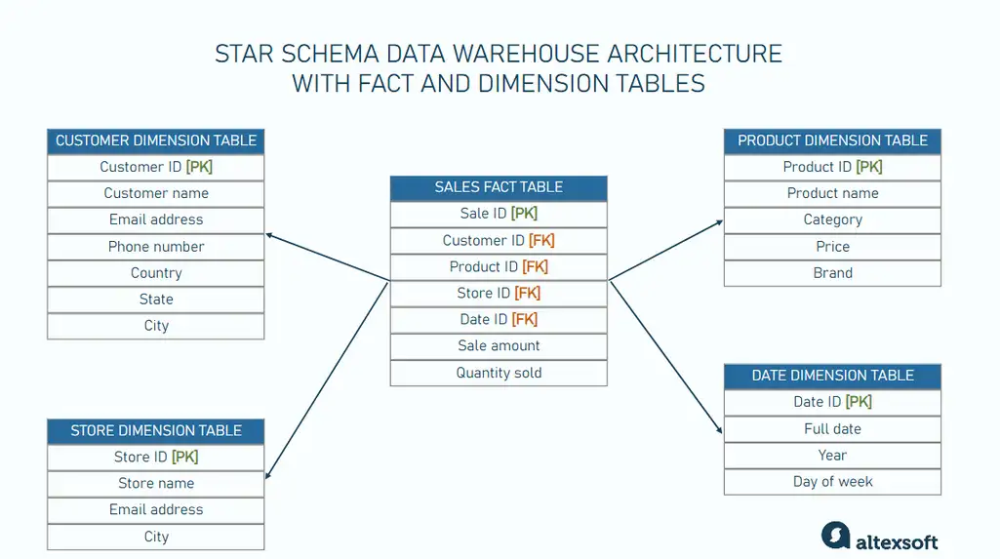
DV vs traditional star schema warehouse

Slide 17
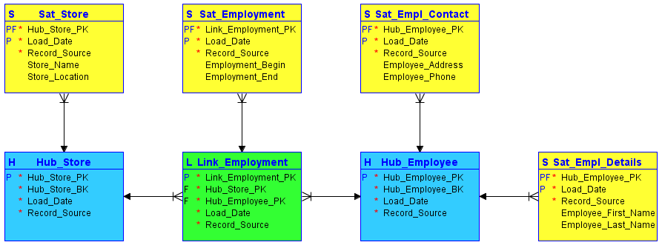
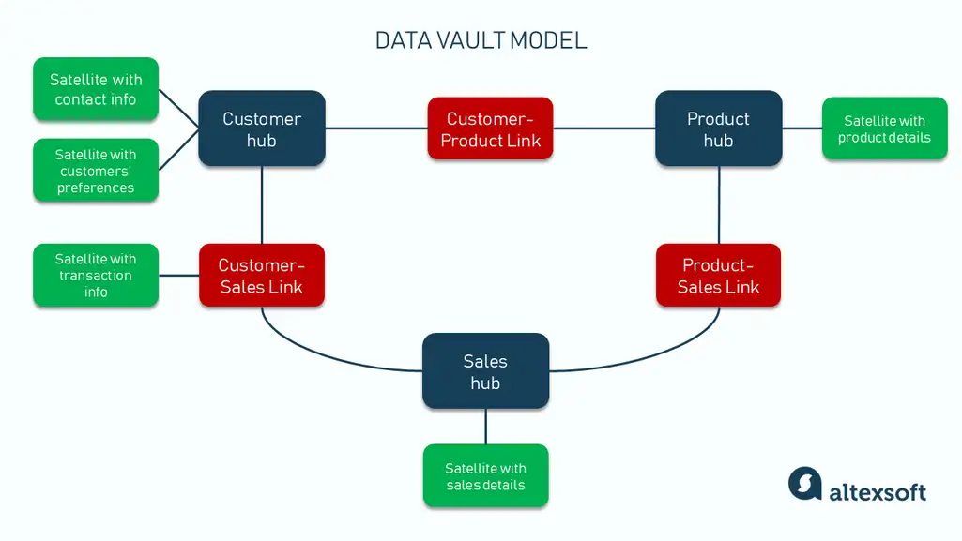
DV modeling

Slide 18

DV components
Hubs
Major component
Unique, unchanging identifiers
Satellites
Descriptive attributes and historical data
Timestamps, text-based descriptions
Links
Relationship between hub tables
Foreign keys, record source

Slide 19
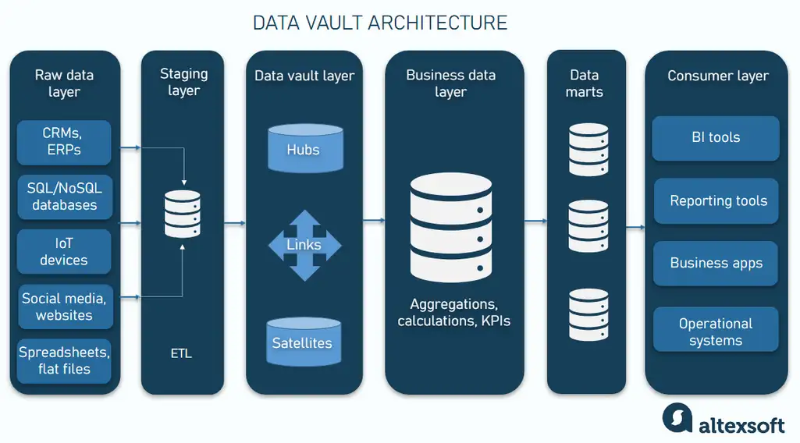
DV architecture
Data processing pipeline
Raw data layer
Staging layer
Data vault layer
Business data layer
Data marts
Consumer layer

Slide 20
Data mart
Smaller data warehouse (size less than 100GB)
Usually when DW starts taking too long and becomes ineffective
Multiple instead of 1
3 main types
Dependent; primary source of information
Independent; standalone systems - no info extraction from external sources
Hybrid; combination
Main difference -> DW = large repository
-> Holds all company extracted data; multiple sources
-> DM = smaller; limited amount of data

Slide 21
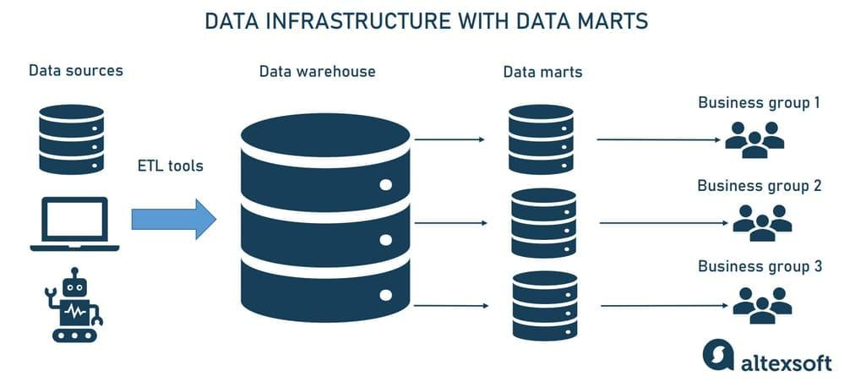
Data mart architecture

Slide 22

Data mart
Limited scope
Has to be efficient, processed & analyzed
Possible due to OLAP cubes

Slide 23
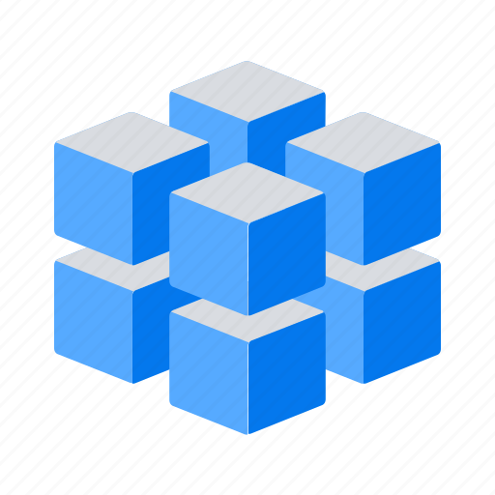
OLAP (online analytical processing)
Computing approach
Analyze multidimensional data (eg. multiple variables)
Interact with databases
types
Molap(multidimension)
Rolap(relational)
Holap
Notes:
multidimensional technieken voorbeeld:
Common Techniques
Multivariate Analysis: Statistical methods that consider multiple variables at once, such as regression analysis or principal component analysis (PCA).
Data Visualization: Tools like scatter plots, heat maps, or 3D charts that help visualize data in more than two dimensions.
Machine Learning: Algorithms like clustering (e.g., K-means) or classification (e.g., decision trees) that can analyze and find patterns in multidimensional data.
voorbeeld parctisch:
For example, a sales department report would include such dimensions as product, region, sales representative, sales amount, month, and so on.

Slide 24
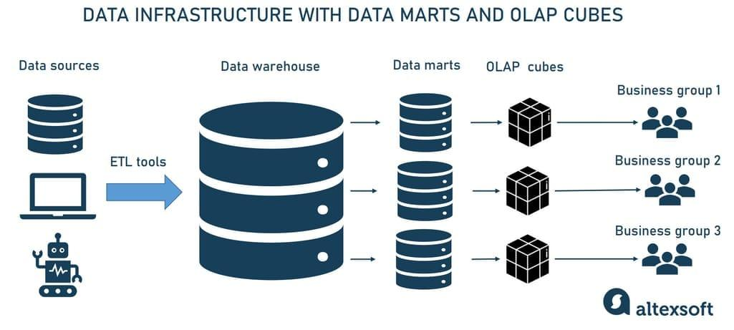
Data structure with data marts and olap cubes

Slide 25

Big data engineering
Massive highly scalable fault-tolerant distributed systems
Rapidly changing large data streams
Real time processing
Data Lake

Slide 26

Data Lake
Pool of saved data
Flexible Data Configuration
Horizontal Scalability
Centralized Repository
Used in ELT
Optimized for Unstructured Data
Convenient for Unclear Data Purpose
Example: hadoop

Slide 27
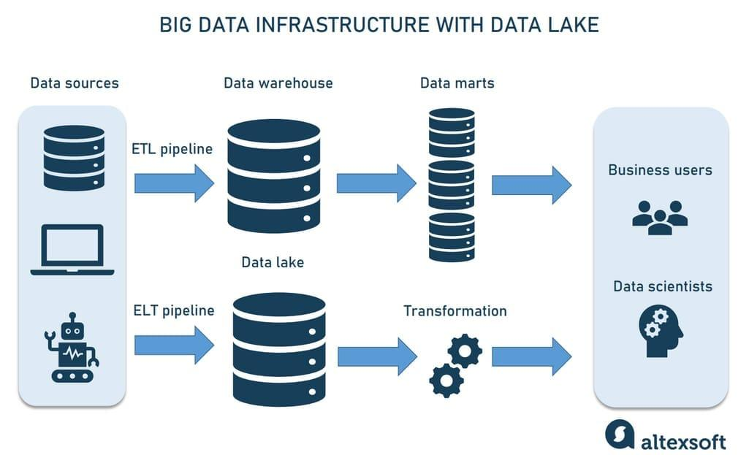
Infrastructure with data lake

Slide 28

Hadoop
Large scale data processing framework in Java
Run data analysis jobs in parallel across servers
3 core components
HDFS: stores big data
Processing engine(map reduce)
Resource manager(YARN)

Slide 29
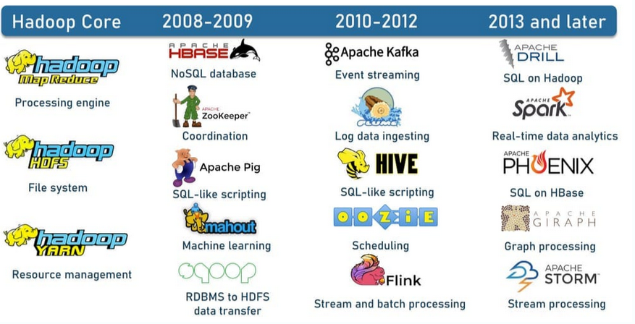
Hadoop ecosystem timeline
Notes:
Some popular instruments within the Hadoop ecosystem are
HBase, a NoSQL database built on top of HDFS that provides real-time access to read or write data;
Apache Pig, Apache Hive, Apache Drill, and Apache Phoenix to simplify Big Data exploration and analysis when working with HBase, HDFS, and MapReduce; and
Apache Zookeeper and Apache Oozie to coordinate operations and schedule jobs across a Hadoop cluster.

Slide 30
sources
https://www.altexsoft.com/blog/what-is-data-engineering-explaining-data-pipeline-data-warehouse-and-data-engineer-role/
https://www.altexsoft.com/blog/data-vault-architecture/

